Slide 1
Cryptography (2022 Fall) principles of modern cryptography, security guarantee, threat model, COA, KPA, CPA, CCA, perfect secrecy
LiangFeng Zhang
zhanglf@shanghaitech.edu.cn
SIST, ShanghaiTech

Slide 2
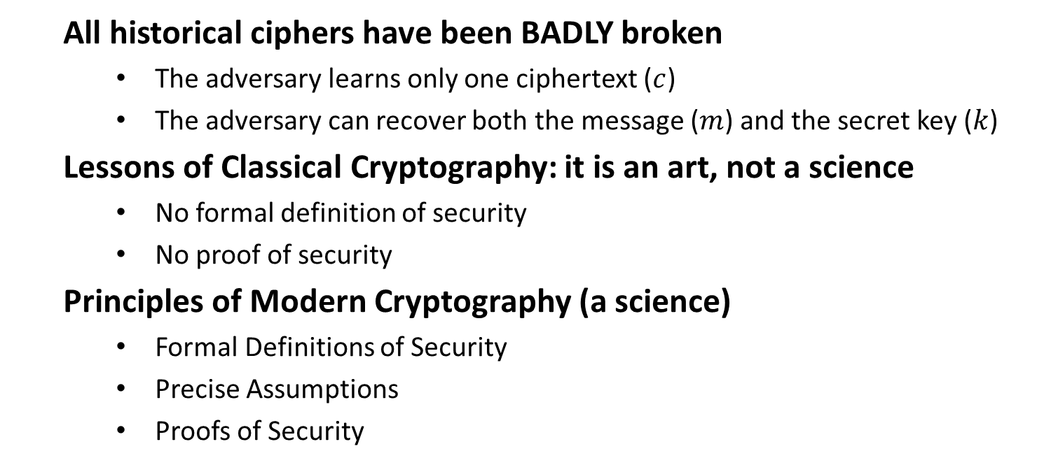
Classical & Modern Cryptography
All historical ciphers have been BADLY broken
The adversary learns only one ciphertext ($c$)
The adversary can recover both the message ($m$) and the secret key ($k$)
Lessons of Classical Cryptography: it is an art, not a science
No formal definition of security
No proof of security
Principles of Modern Cryptography (a science)
Formal Definitions of Security
Precise Assumptions
Proofs of Security

Slide 3
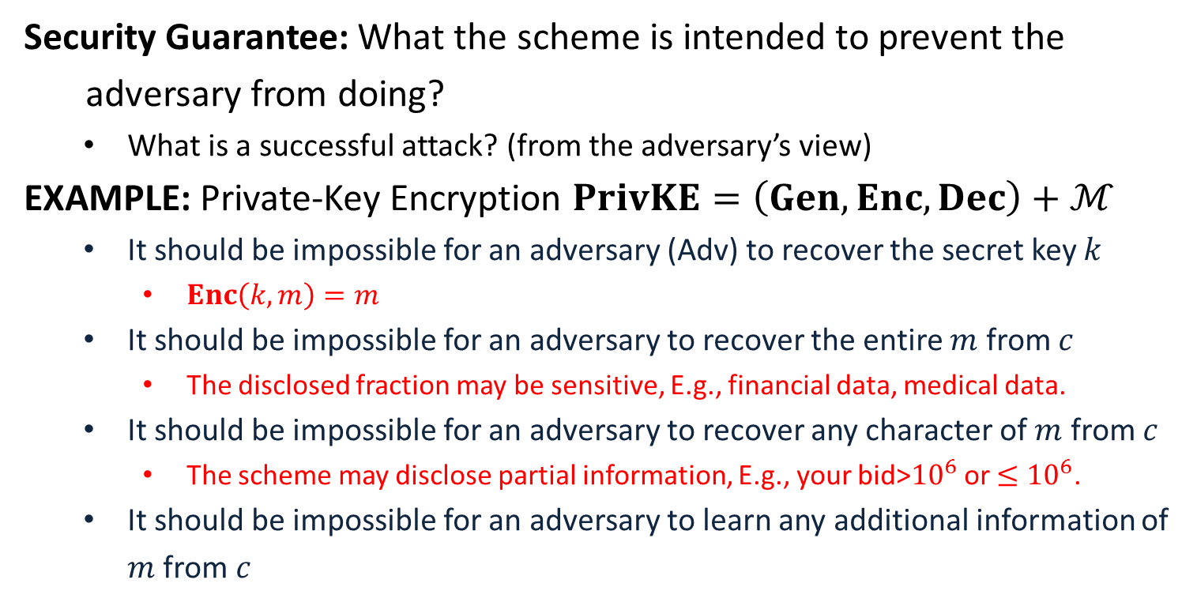
Formal Definitions of Security
Security Guarantee: What the scheme is intended to prevent the
adversary from doing?
What is a successful attack? (from the adversary’s view)
EXAMPLE: Private-Key Encryption $PrivKE=\left(Gen, Enc, Dec\right)+ℳ$
It should be impossible for an adversary (Adv) to recover the secret key $k$
$Enc\left(k,m\right)=m$
It should be impossible for an adversary to recover the entire $m$ from $c$
The disclosed fraction may be sensitive, E.g., financial data, medical data.
It should be impossible for an adversary to recover any character of $m$ from $c$
The scheme may disclose partial information, E.g., your bid>${10}^{6}$ or $≤{10}^{6}$.
It should be impossible for an adversary to learn any additional information of $m$ from $c$
Insecure! The entire plaintext is disclosed to the adversary.
This is a good security guarantee.

Slide 4
Formal Definitions of Security
Threat Model: What actions the adversary is assumed able to carry out
defines the power of the adversary
EXAMPLE: The typical threat models for private-key encryption
Ciphertext-Only Attack (COA):
The adversary observes a ciphertext (or multiple ciphertexts) .
It tries to determine information about the underlying plaintext (or plaintexts).
Shift cipher, substitution cipher and Vigenère Cipher are all broken with COA.
Known-Plaintext Attack (KPA):
The adversary learns one or more pairs of plaintext and ciphertext generated using some key.
It tries to determine information about the underlying plaintext of some other ciphertext produced using the same key.
All historical ciphers are trivial to break with KPA.

Slide 5
Formal Definitions of Security
Chosen-Plaintext Attack (CPA):
The adversary obtains plaintext/ciphertext pairs for plaintexts of its choice.
It tries to determine information about the underlying plaintext of some other ciphertext produced using the same key.
Chosen-Ciphertext Attack (CCA):
The adversary obtains plaintext/ciphertext pairs for plaintexts of its choice and ciphertext/plaintext pairs for ciphertexts of its choice.
It tries to determine information about the underlying plaintext of some other ciphertext produced using the same key.
A Security Definition Looks Like: A cryptographic scheme for a given
task is secure if no adversary of a specific power can achieve a
specified break.

Slide 6
Precise Assumptions
Assumption: Statements that are not proven but conjectured to be true
EXAMPLE: The integer factoring problem is hard.
RSA public encryption; Paillier’s Encryption; …
EXAMPLE: The discrete logarithm problem is hard.
ElGamal encryption; BGN encryption
Modern cryptographic constructions are based on assumptions
Why Precise Assumptions:
Not precise, cannot be studied well, cannot establish confidence
Facilitate the comparison of schemes with different assumptions
Understanding the necessary assumptions

Slide 7
Proofs of Security
Provable Security: If the designed cryptographic scheme can be broken
by an adversary, then the underlying assumption is false.
Proof is relative to the security definition and the assumption
A Theorem Looks like: Assume that X is true (e.g., certain problem is
hard), scheme Y is secure according to the given definition.
A Proof Looks like: Given an adversary A that breaks the scheme Y
according to the definition, using A we can construct something
that falsifies X (solve the problem related to X).

Slide 9
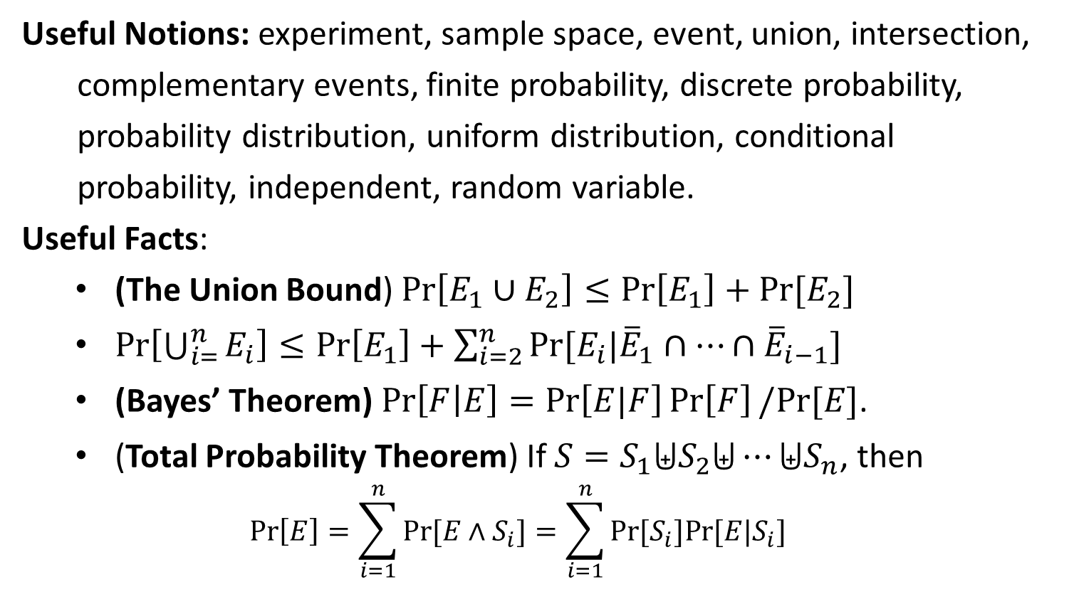
Probability
Useful Notions: experiment, sample space, event, union, intersection,
complementary events, finite probability, discrete probability,
probability distribution, uniform distribution, conditional
probability, independent, random variable.
Useful Facts:
(The Union Bound) $\operatorname{Pr}\left[E_{1}∪E_{2}\right]≤\operatorname{Pr}\left[E_{1}\right]+Pr⁡[E_{2}]$
$\operatorname{Pr}\left[\bigcup_{i=}^{n}{E_{i}}\right]≤\operatorname{Pr}\left[E_{1}\right]+\sum_{i=2}^{n}{Pr⁡[E_{i}|{\overline{E}}_{1}∩⋯∩{\overline{E}}_{i−1}]}$
(Bayes’ Theorem) $\operatorname{Pr}\left[F | E\right]=\operatorname{Pr}\left[E|F\right]\operatorname{Pr}\left[F\right]/Pr⁡[E]$.
(Total Probability Theorem) If $S=S_{1}⨄S_{2}⨄⋯⨄S_{n}$, then
$$\operatorname{Pr}\left[E\right]=\sum_{i=1}^{n}{Pr⁡[E∧S_{i}]}=\sum_{i=1}^{n}{Pr[S_{i}]Pr⁡[E|S_{i}]}$$

Slide 10


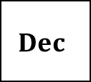


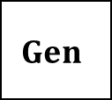

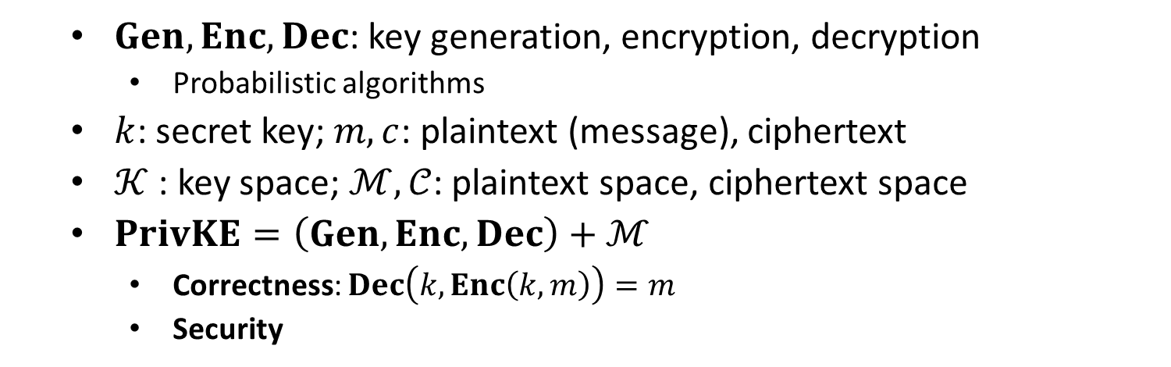
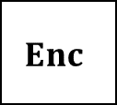


Private-Key Encryption (PrivKE)
$$m$$
$$Enc$$
$$Enc(k, m)=c$$
$$Dec$$
Alice
Bob
$$k$$
$$k$$
$$Dec(k, c)=m$$
$$Gen$$
$Gen, Enc, Dec$: key generation, encryption, decryption
Probabilistic algorithms
$k$: secret key; $m, c$: plaintext (message), ciphertext
$𝒦$ : key space; $ℳ,𝒞$: plaintext space, ciphertext space
$PrivKE=\left(Gen, Enc, Dec\right)+ℳ$
Correctness: $Dec\left(k,Enc\left(k,m\right)\right)=m$
Security

Slide 11
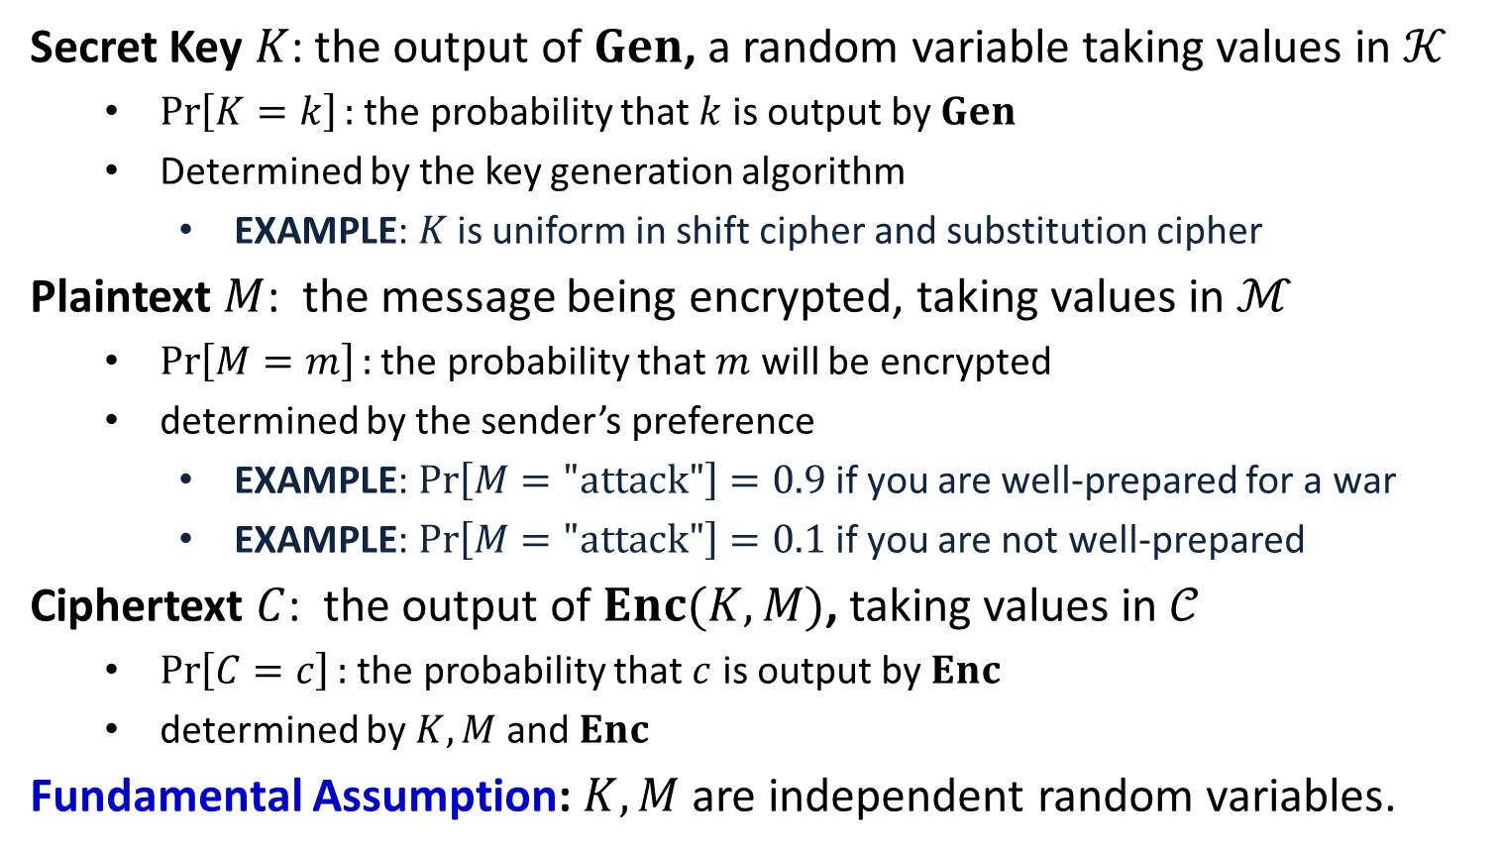
Distributions on $𝒦,ℳ,𝒞$
Secret Key $K$: the output of $Gen$, a random variable taking values in $𝒦$
$\operatorname{Pr}\left[K=k\right]:$ the probability that $k$ is output by $Gen$
Determined by the key generation algorithm
EXAMPLE: $K$ is uniform in shift cipher and substitution cipher
Plaintext $M$: the message being encrypted, taking values in $ℳ$
$\operatorname{Pr}\left[M=m\right]:$ the probability that $m$ will be encrypted
determined by the sender’s preference
EXAMPLE: $\operatorname{Pr}\left[M="\text{attack}"\right]=0.9$ if you are well-prepared for a war
EXAMPLE: $\operatorname{Pr}\left[M="\text{attack}"\right]=0.1$ if you are not well-prepared
Ciphertext $C$: the output of $Enc(K,M)$, taking values in $𝒞$
$\operatorname{Pr}\left[C=c\right]:$ the probability that $c$ is output by $Enc$
determined by $K,M$ and $Enc$
Fundamental Assumption: $K,M$ are independent random variables.

Slide 12
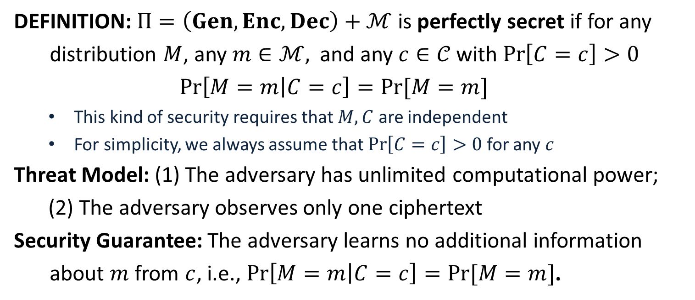
Perfect Secrecy
DEFINITION: $Π=\left(Gen, Enc, Dec\right)+ℳ$ is perfectly secret if for any
distribution $M$, any $m∈ℳ,$ and any $c∈𝒞$with $\operatorname{Pr}\left[C=c\right]>0$
$$\operatorname{Pr}\left[M=m | C=c\right]=Pr⁡[M=m]$$
This kind of security requires that $M,C$ are independent
For simplicity, we always assume that $\operatorname{Pr}\left[C=c\right]>0$ for any $c$
Threat Model: (1) The adversary has unlimited computational power;
(2) The adversary observes only one ciphertext
Security Guarantee: The adversary learns no additional information
about $m$ from $c$, i.e., $\operatorname{Pr}\left[M=m | C=c\right]=Pr⁡[M=m]$.

Slide 13
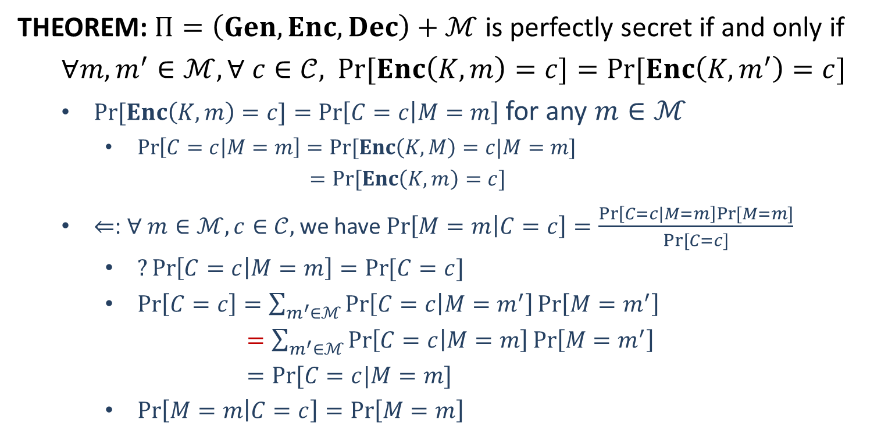
Perfect Secrecy
THEOREM: $Π=\left(Gen, Enc, Dec\right)+ℳ$ is perfectly secret if and only if
$∀m, m^{′}∈ℳ, ∀ c∈𝒞,$ $\operatorname{Pr}{[Enc\left(K,m\right)=c]}=Pr⁡[Enc\left(K,m^{′}\right)=c]$
$\operatorname{Pr}{[Enc\left(K,m\right)=c]}=\operatorname{Pr}\left[C=c | M=m\right]$ for any $m∈ℳ$
$\operatorname{Pr}\left[C=c | M=m\right]=Pr⁡[Enc\left(K,M\right)=c|M=m]$
$=Pr⁡[Enc\left(K,m\right)=c]$
$⇐$: $∀ m∈ℳ, c∈𝒞,$ we have $\operatorname{Pr}\left[M=m | C=c\right]=\frac{\operatorname{Pr}\left[C=c|M=m\right]Pr⁡[M=m]}{Pr⁡[C=c]}$
$?\operatorname{Pr}\left[C=c | M=m\right]=\operatorname{Pr}{[C=c]}$
$\operatorname{Pr}\left[C=c\right]=\sum_{m^{′}∈ℳ}{\operatorname{Pr}\left[C=c | M=m^{′}\right]\operatorname{Pr}\left[M=m^{′}\right]}$
$=\sum_{m^{′}∈ℳ}{\operatorname{Pr}\left[C=c | M=m\right]\operatorname{Pr}\left[M=m^{′}\right]}$
$=Pr⁡[C=c|M=m]$
$\operatorname{Pr}\left[M=m | C=c\right]=\operatorname{Pr}\left[M=m\right]$

Slide 14
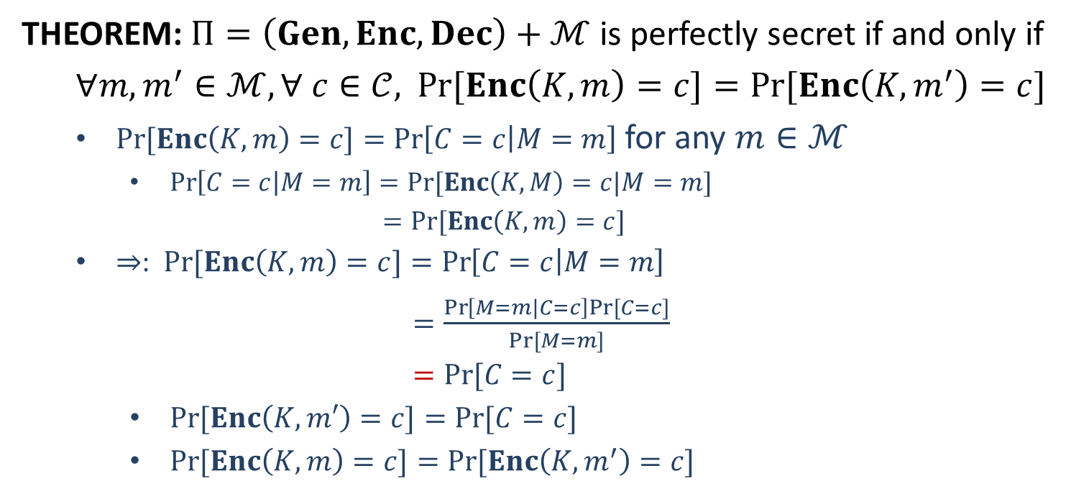
Perfect Secrecy
THEOREM: $Π=\left(Gen, Enc, Dec\right)+ℳ$ is perfectly secret if and only if
$∀m, m^{′}∈ℳ, ∀ c∈𝒞,$ $\operatorname{Pr}{[Enc\left(K,m\right)=c]}=Pr⁡[Enc\left(K,m^{′}\right)=c]$
$\operatorname{Pr}{[Enc\left(K,m\right)=c]}=\operatorname{Pr}\left[C=c | M=m\right]$ for any $m∈ℳ$
$\operatorname{Pr}\left[C=c | M=m\right]=Pr⁡[Enc\left(K,M\right)=c|M=m]$
$=Pr⁡[Enc\left(K,m\right)=c]$
$⇒$: $\operatorname{Pr}{[Enc\left(K,m\right)=c]}=\operatorname{Pr}\left[C=c | M=m\right]$
$=\frac{\operatorname{Pr}\left[M=m|C=c\right]Pr⁡[C=c]}{Pr⁡[M=m]}$
$=Pr⁡[C=c]$
$\operatorname{Pr}{[Enc\left(K,m′\right)=c]}=Pr⁡[C=c]$
$\operatorname{Pr}{[Enc\left(K,m\right)=c]}=Pr⁡[Enc\left(K,m^{′}\right)=c]$

